Slide 1
Network Theory: Culture Conversion Theory and Cultural Matching

Slide 2
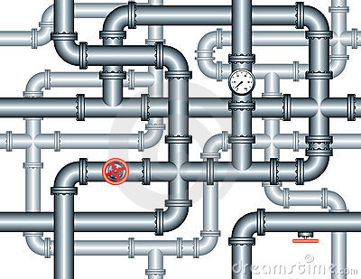
The pipes, flows and influence model
Static model of network ties
  “Network position” causes social behaviors
  Network ties are relatively stable “pipes” through which things – objects, information or cultural influence – flow (Borgatti 2005)
    Network ties operate as causes
Mechanisms producing similarity:
  Lateral influence via role-modeling of socio-demographically proximate alters (Christakis and Fowler 2011)
  Hierarchical influence via the adoption of the behaviors of high status individuals (Friedkin 2006)

Slide 3
The pipes, flows and influence model
Recent research and theory on the dynamics of dyadic relationships reveals a different picture
  Rather than being relatively static pipes:
    Network ties are formed, dissolved and re-negotiated in relatively narrow time-windows (Burt, 2000; Burt, 2002; Raeder et al 2011)
    Neither flow nor positional processes can be conceptualized independently from these fine-grained temporal dynamics (Moody 2002)

Slide 4
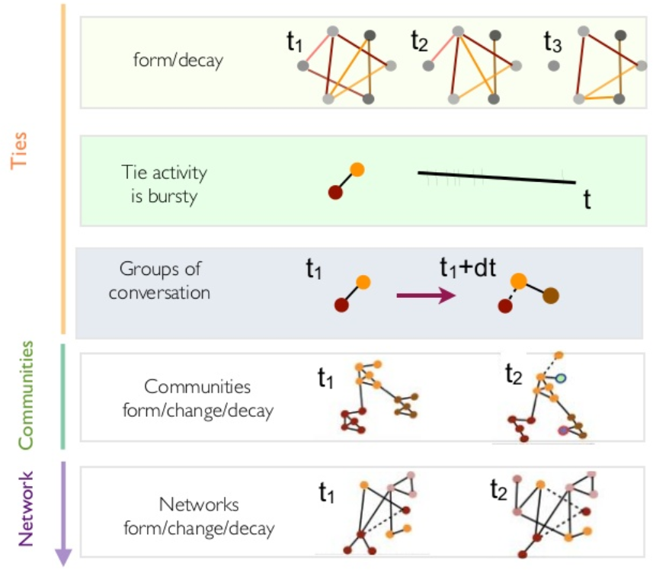
From flows to dynamic evolution and self-selection
If social relations are constantly evolving they:
  Cannot always be causes
  Change at a faster rate than the majority of the cultural outcomes that they are putatively causing (Lizardo 2006; Lizardo and Vaisey 2010.
Another possibility:
  Persons (within environmental and structural constraints) that are doing things to network relations
    e.g. enacting them, neglecting them, choosing to keep them or dissolving them

Slide 5
From flows to dynamic evolution and self-selection
This emphasis has brought back a concern with classical questions regarding:
  The origins and short-term fate of personal relationships
  The factors that account for their persistence through time
    Network ties may result in the strengthening or weakening of cultural propensities
    The emergence of certain cultural propensities may be responsible for the strengthening and weakening of network ties

Slide 6
Evidence of cultural effects on networks
Individuals who report being in poor health:
  Tend to have smaller networks in comparison to their healthy peers (Haas et al 2010, Cornwell 2009)
  Tend to be more peripheral in the overall structure
Depressed individuals:
  Occupy more peripheral positions because they withdraw from social contact
  Have high “homophily” because they befriend similarly other peripheral persons who are also more likely to be depressed persons (Schaefer et al 2011)

Slide 7
Evidence of cultural effects on networks
High self monitors (persons who consciously strategize as to how they present themselves to others):
  Are more likely to occupy central positions in networks (Mehra, Kilduff and Brass 2001)
  Tend to attract more new friends, bridge structural holes, and "churn" through more ties (Sasovova et al 2010)
Persons who have implicit self-understandings as collaborative:
  Are more likely to form ties across organizational divisions (Srivastava and Banaji 2011)

Slide 8
The culture conversion model
Established phenomenon in the study of culture and social networks
Erickson (1996: 247) notes that
  “The more diverse the set of…contacts one has, the more variety of culture one will encounter and hence maintain or learn…Thus network variety is one important source of cultural variety”
DiMaggio (1987: 444) adds that
  “wide-ranging networks require broad repertoires of taste.”
Lizardo (2006) argues and shows that:
  Not only do diverse networks lead to cultural diversity, culture consumption diversity leads to heterogeneous networks
First observation: Network size (degree) should be correlated with culture consumption diversity

Slide 9
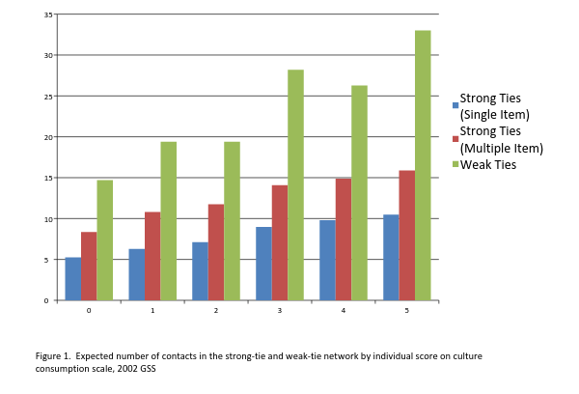

Slide 10
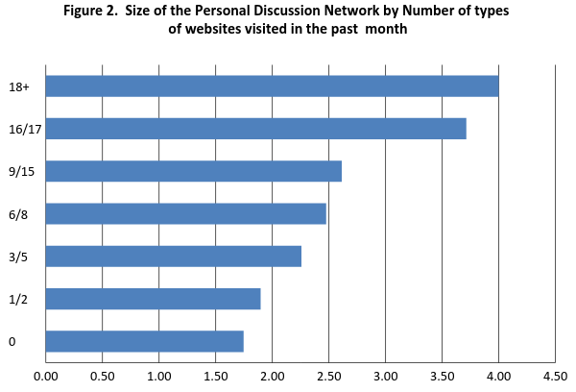

Slide 11
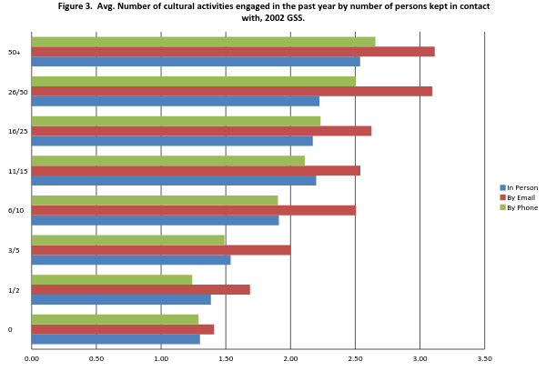

Slide 12
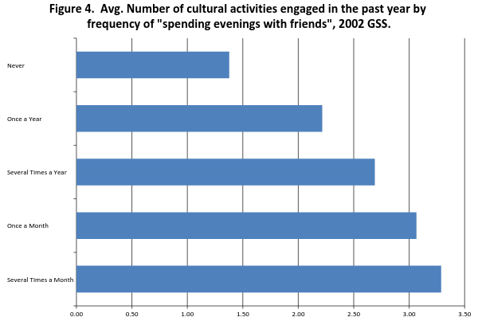

Slide 13
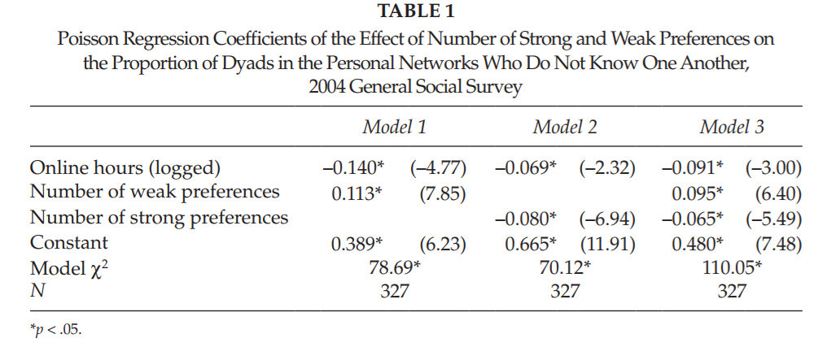
From conduits to culture conversion
The logic of the conversion model can be extended to the case of redundancy (e.g. Burt 1992) in ego-networks
  The more actors spread their attention across a wide variety of cultural pursuits (the larger the number of “weak” preferences), the less likely are their contacts to be connected to one another (Lizardo 2011)

Slide 14
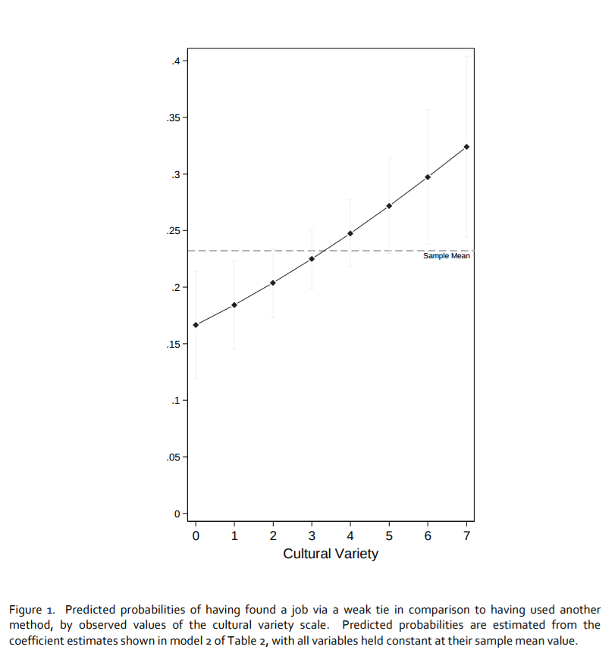
From conduits to culture conversion
A similar logic can be used to link the culture conversion imagery to Granovetter’s (1973) classic proposition
  Lizardo (2013) finds that persons who report engaging in a wide variety of cultural activities are more likely to have found out about their last job via a social contact, especially a weak tie

Slide 15
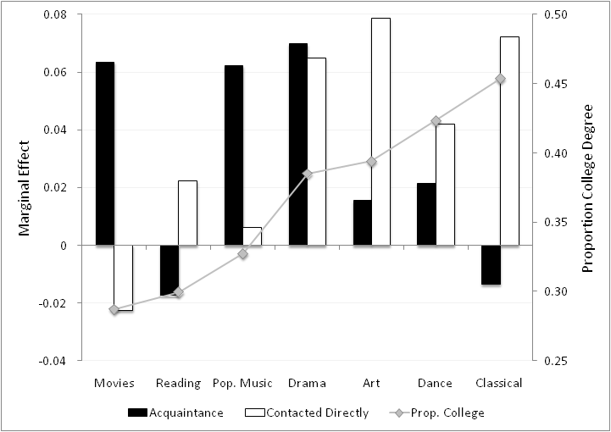
From conduits to culture conversion
A similar logic can be used to link the culture conversion imagery to Granovetter’s (1973) classic proposition
  Different types of culture help with different types of weak tie activation:
    Popular culture is correlated with indirect weak tie activation
    Elite culture is correlated with direct weak tie activation

Slide 16
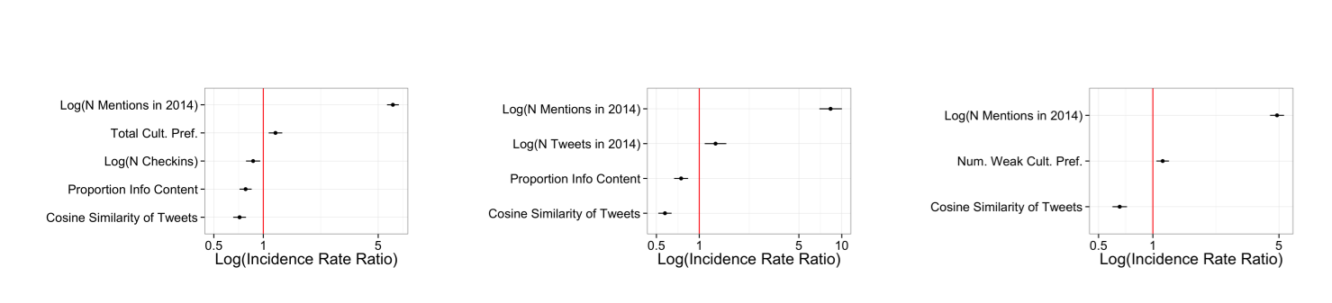
From conduits to culture conversion
Joseph and Carley (2015) test four postulates from the culture conversion model using linked Twitter and Foursquare data
  The more strong (weak) cultural preferences one has, the more (less) closed one’s ego network is
  The more total cultural preferences one has, the more total social ties one has
  The more strong cultural preferences one has, the more strong ties one has
  The more weak cultural preferences one has, the more weak ties one has

Slide 17
From conduits to culture conversion
Joseph and Carley (2015) test four postulates from the culture conversion model using linked Twitter and Foursquare data
  The more strong (weak) cultural preferences one has, the more (less) closed one’s ego network is
  The more total cultural preferences one has, the more total social ties one has
  The more strong cultural preferences one has, the more strong ties one has
  The more weak cultural preferences one has, the more weak ties one has

Slide 18
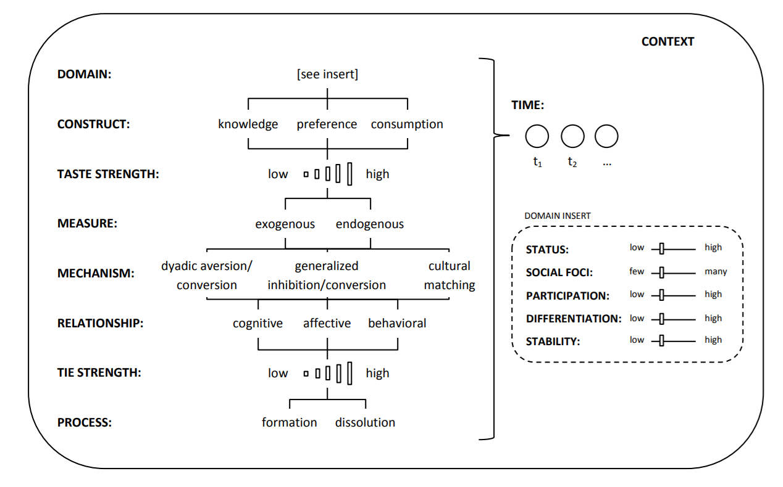
From conduits to culture conversion
Lewis and Kaufman (forthcoming) distinguish between different types of culture conversion processes
  Dyadic conversion
    Cultural forms that help ego form and sustain connections with particular others
  Generalized conversion
    Cultural forms that help ego connects with other people in general
  Cultural matching
    Overall similarity in the cultural profile of two people

Slide 19
From conduits to culture conversion
Some types of culture have generalized conversion capacity
  Some types of culture have negative generalized conversion potential
    They make people less central!
Dyadic conversion is empirically distinct from cultural matching
  People seem to be attuned to overall cultural similarity within dyads
Conversion effects independent of social foci
  Except for some elite tastes
Different tastes matter at different stages of relationship formation
  Locally rare or unusual tastes mattern more for dyadic conversion at the beginning
  Overall profile similarity also matters more at the beginning
  Generalized conversion is aided by tastes that are locally popular but hindered by globally popular tastes

Slide 20
From conduits to culture conversion
Some types of culture have generalized conversion capacity
  Some types of culture have negative generalized conversion potential
    They make people less central!
Dyadic conversion is empirically distinction from cultural matching
  People seem to be attuned to overall cultural similarity within dyads
Conversion effects independent of social foci
  Except for some elite tastes
Different tastes matter at different stages of relationship formation
  Later on, having a diverse range of tastes (music, books) helps in generalized conversion
    Diverse taste in movies however functions as negative generalized cultural capital
  However, sharing globally popular tastes leads to negative dyadic conversion (aversion)

Slide 21
From conduits to culture conversion
Some types of culture have generalized conversion capacity
  Some types of culture have negative generalized conversion potential
    They make people less central!
Dyadic conversion is empirically distinction from cultural matching
  People seem to be attuned to overall cultural similarity within dyads
Conversion effects independent of social foci
  Except for some elite tastes
Different tastes matter at different stages of relationship formation
  At the latest stage:
    Dyadic conversion still in effect
    Locally common culture provides generalized conversion value
      Consistent with a qualified version of the conversion model

Slide 22
Generalized culture conversion theory
Propositions:
  P1. People who share tastes and nontastes across multiple domains and people who share tastes that are locally uncommon are more likely to connect at the initial network formation stage.
  P2. Tastes that are relatively common in a particular environment constitute a broad cultural resource that facilitates generalized culture conversion.
  P3. People who express tastes that are locally valued will be most attractive as potential friends and people who express tastes that are locally disvalued will be avoided.
  P4. People who share tastes that are locally disvalued are unattractive to one another as potential friends.
  P5. Mundane similarities (i.e. sharing any tastes) become more salient as networks evolve.
  P6. People who self-select into shared foci on the basis of their tastes become friends rapidly or not at all; after that the impact of tastes on ties is largely direct.

Slide 23
Generalized culture conversion theory

Slide 24
Second generation work: Mechanisms in context
Cultural matching
  Most well-studied (and theorized) class of mechanisms
  Goes all the way back to Lazarsfeld and Merton (1954) proposal for “value homophily” as an input into relationship formation processes
  Selection into (e.g. econometric) logic
Cultural mismatching
  Involved in relationship dissolution processes
  Selective “unfriending” as a dynamic outcome (Noel and Nyhan 2011)
  Selectionist (e.g. Darwinian logic)

Slide 25
Homophily via preference and self-selection
Persons may already display substantial cultural similarity prior to the formation of the relevant relationships
  This “choice homophily” model postulates that cultural and other personal attributes serve as a self-selection mechanism in tie formation.
According to this model:
  Interaction comes after the fact of cultural matching
  Individuals first develop durable (e.g. habitual) cultural dispositions
  Later select friends based on their similarity on the relevant cultural attributes
  Assumption is that individual cultural predispositions are durable and exhibit “slower” dynamics than more volatile social relations
    (Bidart and Lavenu 2005; Vaisey and Lizardo 2006)

Slide 26
Homophily via dyadic evolution processes
High probabilities of tie dissolution after formation are the result of strong selective pressures that operate early in the relationship building process.
Persons learn whether or not they are similar to someone they have met, and/or they experience imbalance in the relationship (non-reciprocity), leading them to stop interacting with the other person
Recent work shows that homophily can come from:
  The selective dissolution of social ties characterized by cultural mismatch (presuming initial random mixing) than the active choice of similar partners to form a relationship (Noel and Nyhan 2011)
  According to this endogenous evolutionary model, persons do not (initially) “choose” their partners based on cultural commonality, possibly because they lack relevant information on the cultural propensities of acquaintances prior to interacting with them

Slide 27
Homophily via dyadic evolution processes
High probabilities of tie dissolution after formation are the result of strong selective pressures that operate early in the relationship building process.
Persons learn whether or not they are similar to someone they have met, and/or they experience imbalance in the relationship (non-reciprocity), leading them to stop interacting with the other person
Recent work shows that homophily can come from:
  The selective dissolution of social ties characterized by cultural mismatch (presuming initial random mixing) than the active choice of similar partners to form a relationship (Noel and Nyhan 2011)
  Cultural matching emerges in a population as:
    Mismatched ties are selectively removed (due to their higher mortality hazard)
    Matched ties are selectively retained (due to their slower decay propensities).

Slide 28
Connection between cultural tastes and networks
Empirical implications of the model for dynamic ego-networks
  Cultural matching matters for relationship persistence in dynamic ego-networks subject to tie decay
    More matching = more persistence
    Net of standard relational factors (e.g. closeness, duration, foci)
  Cultural matching matters more for the persistence elective (non-kin) ties
    Kin ties persist via alternative mechanisms
  Cultural matching matters more in periods in which persons are “reconfiguring” their networks
    Life-course transitions (Suitor et al. 1997)

Slide 29
Testing the cultural matching model
NetSense Data
  Survey data: Prior to arrival on campus students completed two surveys
    And then subsequently at the beginning and end of the spring semester of their Freshman year
    Demographic/Attitudes/Tastes/Behaviors
  Ego network survey data: Asked about their top 20 contacts
    Standard name-generator (based on interaction frequency)
    Standard name-interpreter
    “Cultural matching” name-interpreter
  Longitudinal network data collected during a key life course-transition
    Suitable for testing the implications of the cultural matching model

Slide 30
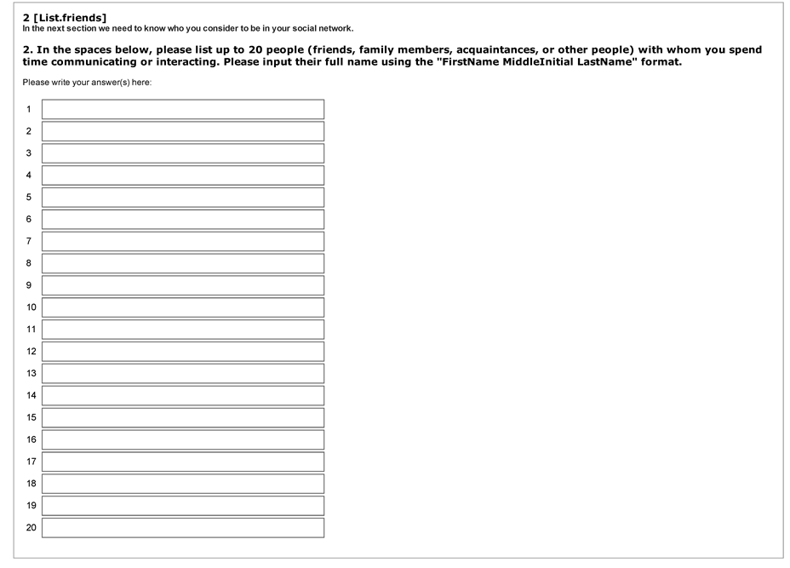
Name Generator data collected on up to 20 contacts

Slide 31
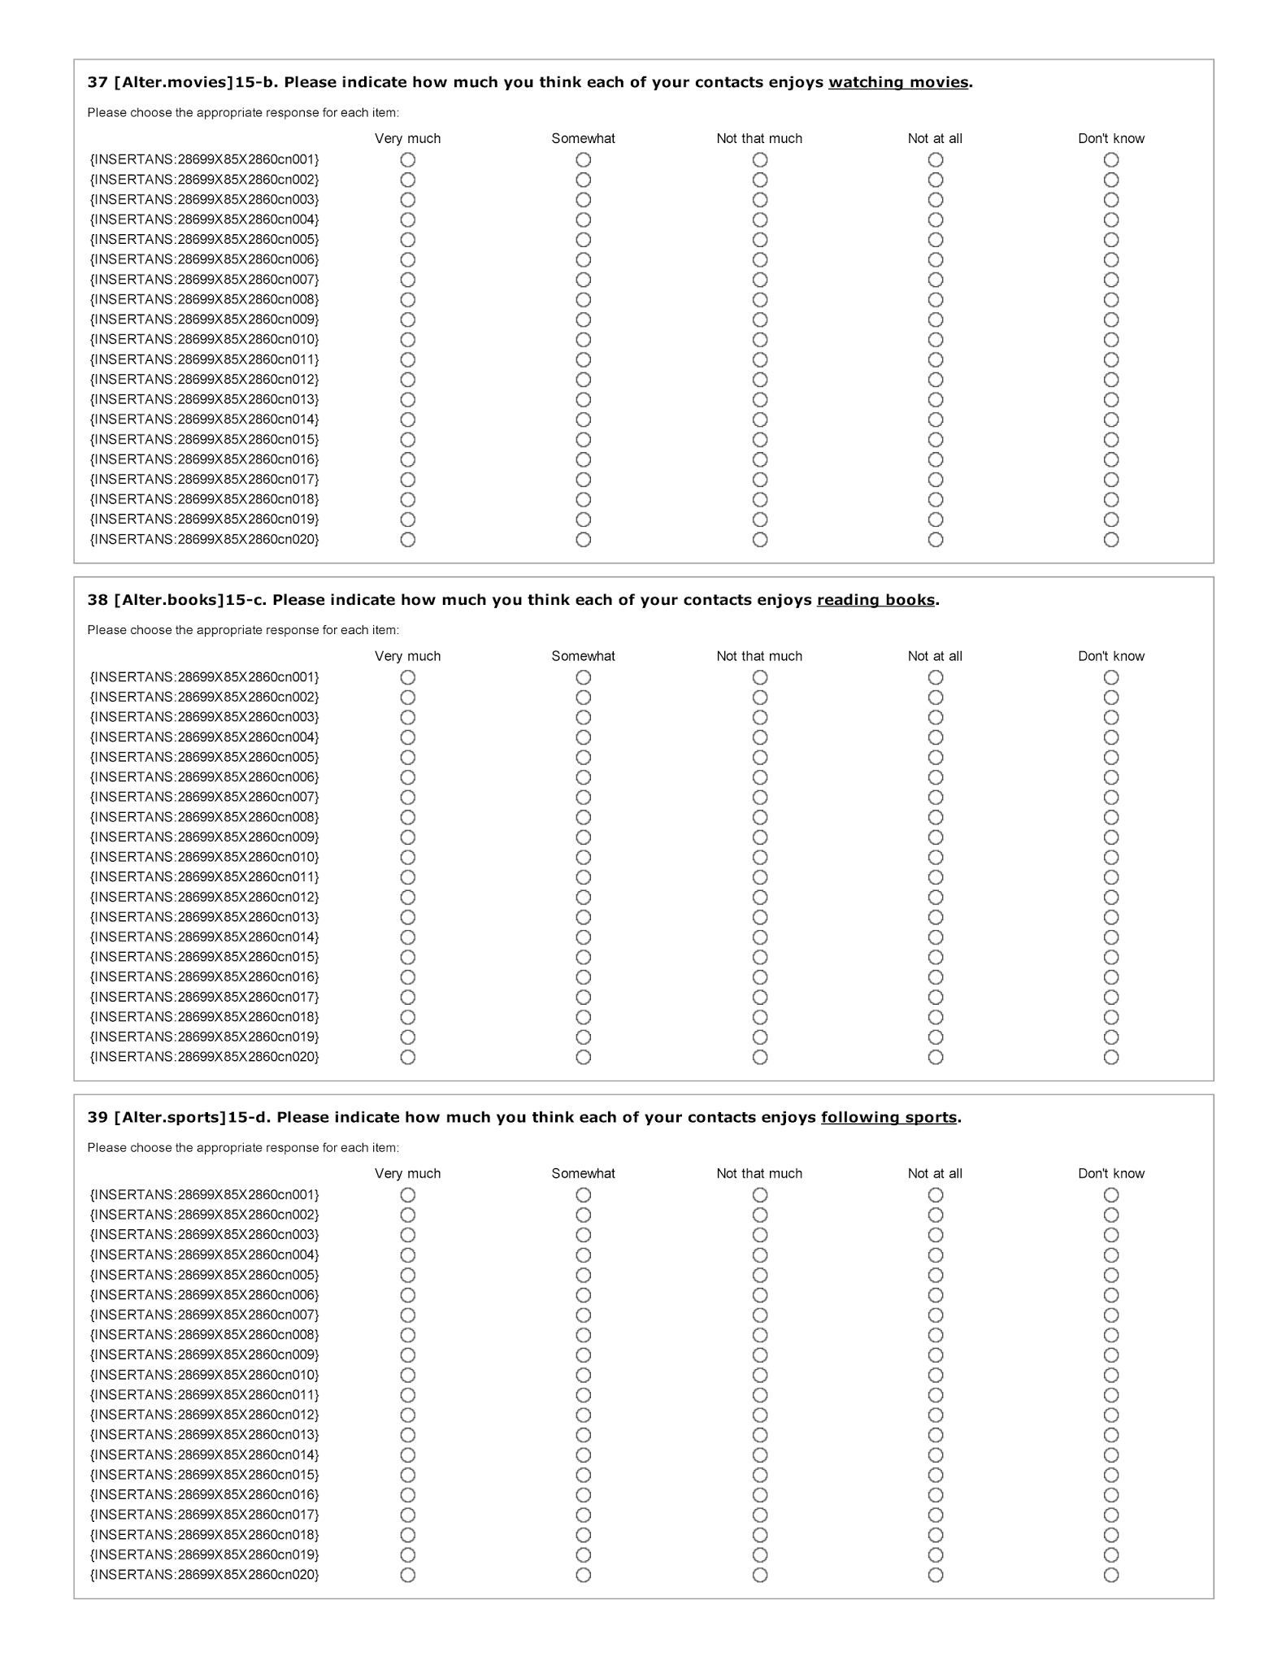
Name interpreter data collected on five activities: (1) Listening to Music, (2) Watching movies, (3) Reading Books, (4) Following Sports, (5) Playing Games, (6) Engaging in outdoor Activities.

Slide 32
Persons filled out a survey about their enjoyment of the same activities on a subsequent survey taken around the same time

Slide 33
Question
Does cultural matching predict relationship persistence?
  Persistence metric:
    Whether a given contact is reported as a frequent interactant in a subsequent survey after being nominated in an earlier survey
  Cultural matching metric:
    Count of the number of activities in which ego reports the same level of involvement as their contacts (as perceived by ego)
  Two periods
    August of 2011 to January of 2012 and January of 2012 to May of 2012
  August of 2011:
    Network mainly composed of off-campus/hometown relations (arriving Freshmen)
  Spring of 2012
    Frequent Interaction Network includes a significant proportion of on-campus relations
      On campus ties on Spring of 2012: 49%

Slide 34
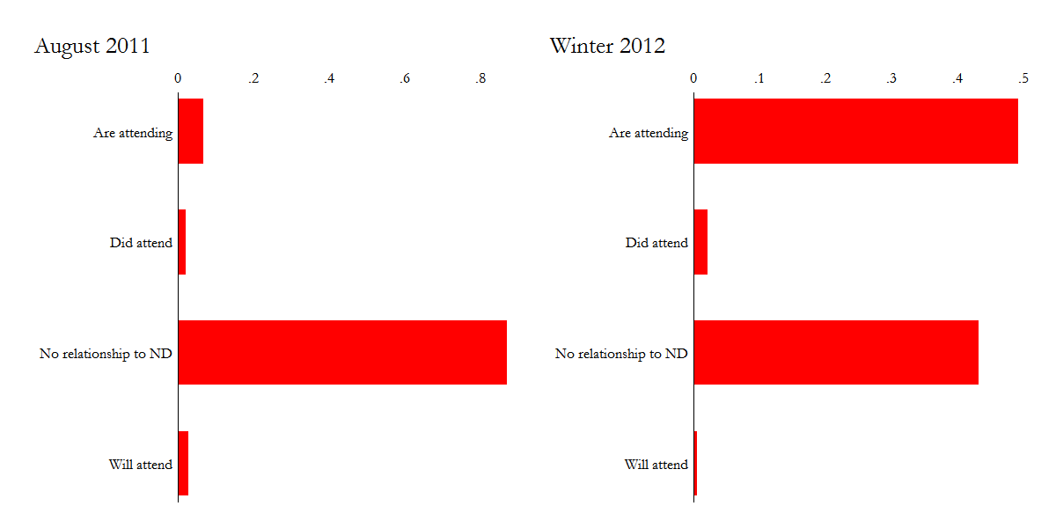
Network relations at two time points

Slide 35
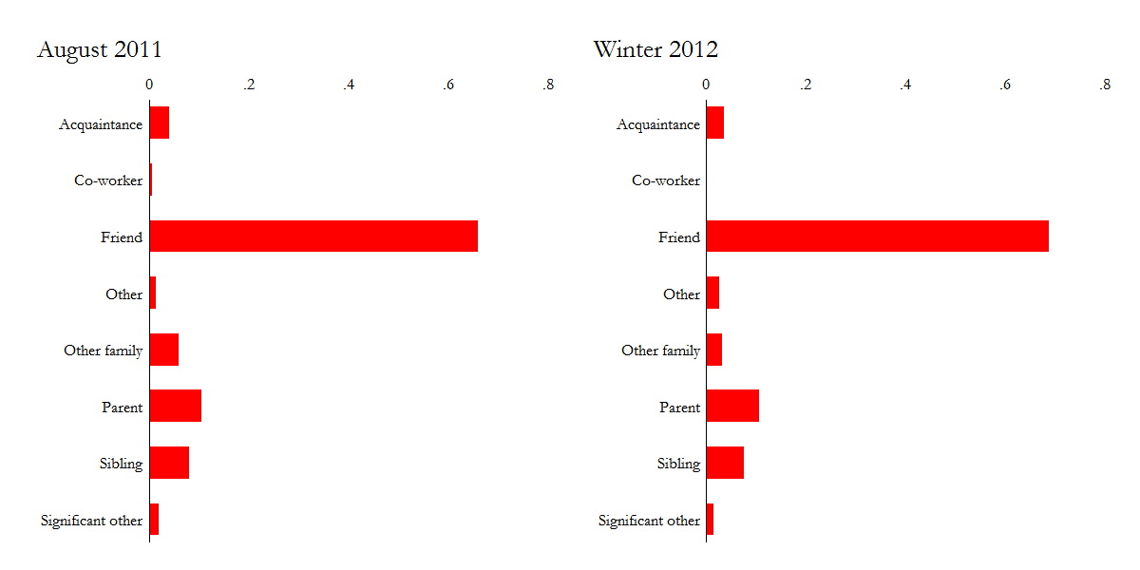
Network relations at two time points

Slide 36
Question
Method
  Random effects logistic regression predicting whether a relation observed at t is also observed at t + 1
    Relations nested within egos (Van Duijn et al. 1999)
  Allows for inclusion of ego-level and relation-level predictors
    Ego-Level:
      Mean tie duration
      Mean relationship closeness
      Network size
      Gender
      Race

Slide 37
Question
Method
  Random effects logistic regression predicting whether a relation observed at t is also observed at t + 1
    Relations nested within egos (Van Duijn et al. 1999)
  Allows for inclusion of ego-level and relation-level predictors
    Tie-Level:
      Alter Gender
      Same Gender Tie
      Duration (Years)
      Subjective Closeness (Ordinal Scale)
      On-Campus (Yes/No)
      Kin/Non-Kin
      Cultural matching
      N. of Unknown Tastes

Slide 38
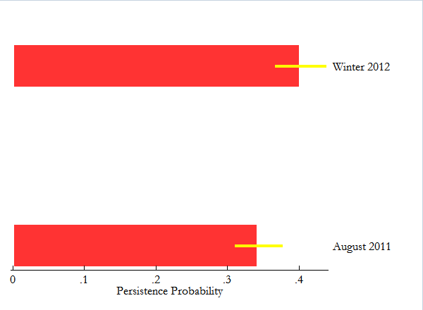
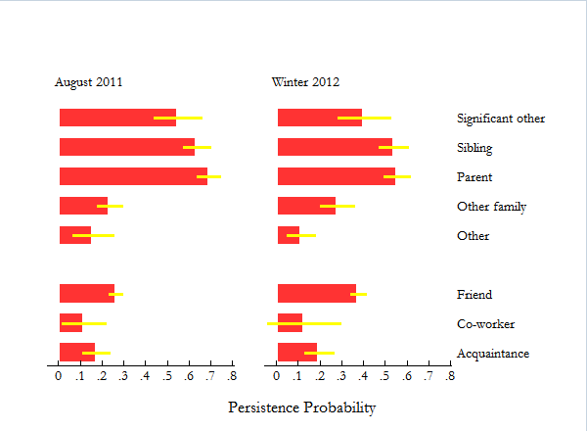
Tie persistence over time

Slide 39
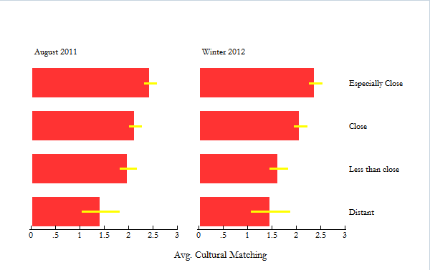
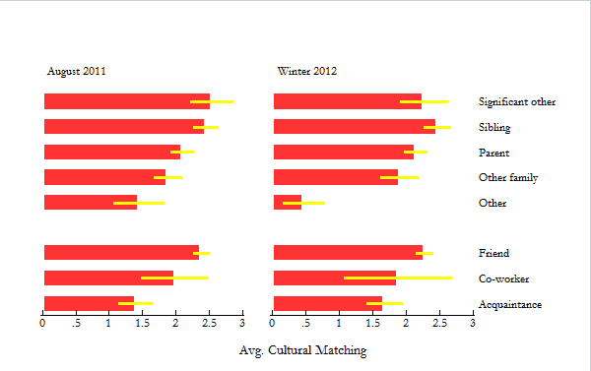
Cultural matching by tie strength and rel. type

Slide 40
 | Additive | Interaction
Person Level Effects
Avg. Network Closeness | -0.448* | -0.463*
 | (0.183) | (0.184)
Avg. Tie Duration | -0.0952** | -0.104***
 | (0.0300) | (0.0303)
Network Size | -0.0736*** | -0.0762***
 | (0.0146) | (0.0148)
Race (Black) | -0.930 | -0.924
 | (0.494) | (0.501)
Race (Hispanic) | -0.235 | -0.227
 | (0.390) | (0.395)
Race (Asian) | -1.174** | -1.198**
 | (0.388) | (0.393)
Gender (Female) | 0.343 | 0.357
 | (0.248) | (0.251)
Female Alter | -0.0216 | -0.0224
 | (0.0998) | (0.1000)
Female X Female Alter | 0.122 | 0.131
 | (0.147) | (0.147)
N (Persons) | 202 | 202
N (Ties) | 5587 | 5587

Slide 41
N. of Cultural Matches | 0.0959*** | 0.0362
 | (0.0283) | (0.0444)
N. of Unknown Tastes | -0.0793* | -0.0741
 | (0.0393) | (0.0399)
Kin Tie | 0.432** | 0.499*
 | (0.161) | (0.254)
Subjective Closeness | 1.106*** | 1.106***
 | (0.0663) | (0.0666)
Tie Age | 0.0439*** | 0.0470***
 | (0.0115) | (0.0116)
On Campus Tie | 1.078*** | 0.949***
 | (0.111) | (0.114)
Wave (Winter ‘12) | -0.231* | -0.324
 | (0.103) | (0.172)
Kin Tie X N. Cult. Matches |  | 0.0902
 |  | (0.0820)
Wave X N. Cult. Matches |  | 0.133*
 |  | (0.0551)
Kin Tie X Wave |  | -0.142
 |  | (0.310)
Kin Tie X Wave X N. of Cult. Matches |  | -0.259*
 |  | (0.113)

Slide 42
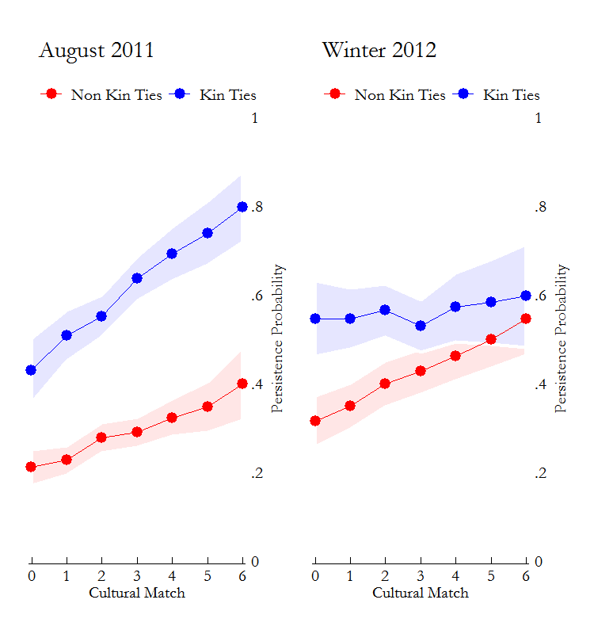
Cultural matching predicts persistence
  During initial transition
    Both Kin and non-kin ties
  After network reconfiguration
    Non-kin ties only

Slide 43
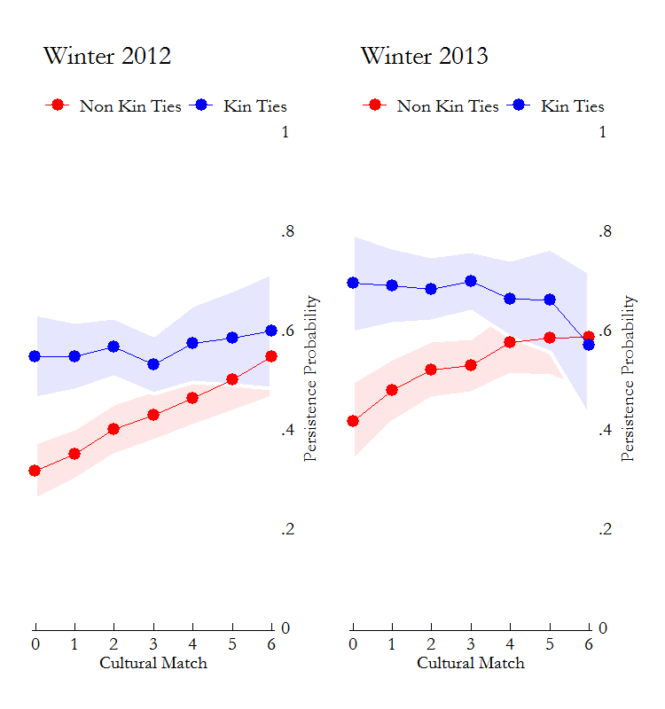
Cultural matching predicts persistence
  During initial transition
    Both Kin and non-kin ties
  After network reconfiguration
    Non-kin ties only
  Cultural matching effect can be observed a year later

Slide 44
Conclusions
Cultural matching matters for tie persistence!
  Strong test as models control for relationship type, relationship closeness, and tie duration
  Cultural matching matters for some relations but not others
    Useful for constructing “elective” (non-kin) relations
  Particularly important as network gets reconfigured around new friendships while old ties need to be maintained at a distance
    Cultural matching matters for the maintenance of “networked communities” (Wellman 1999)

